Slide 1
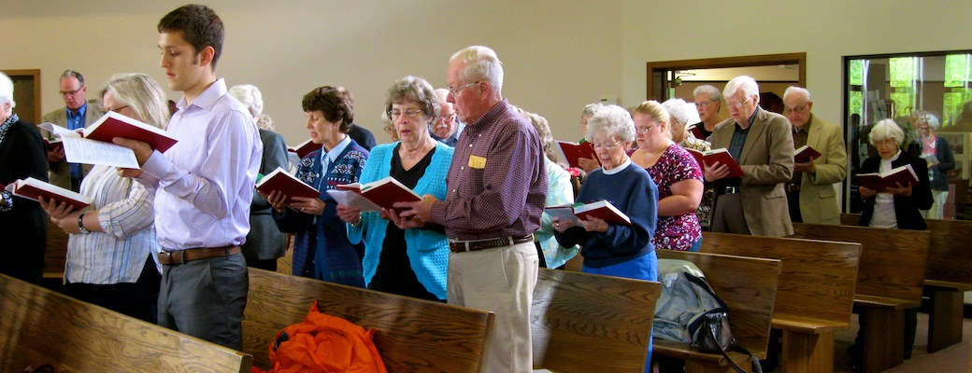
Worshiping God in Song

Slide 2

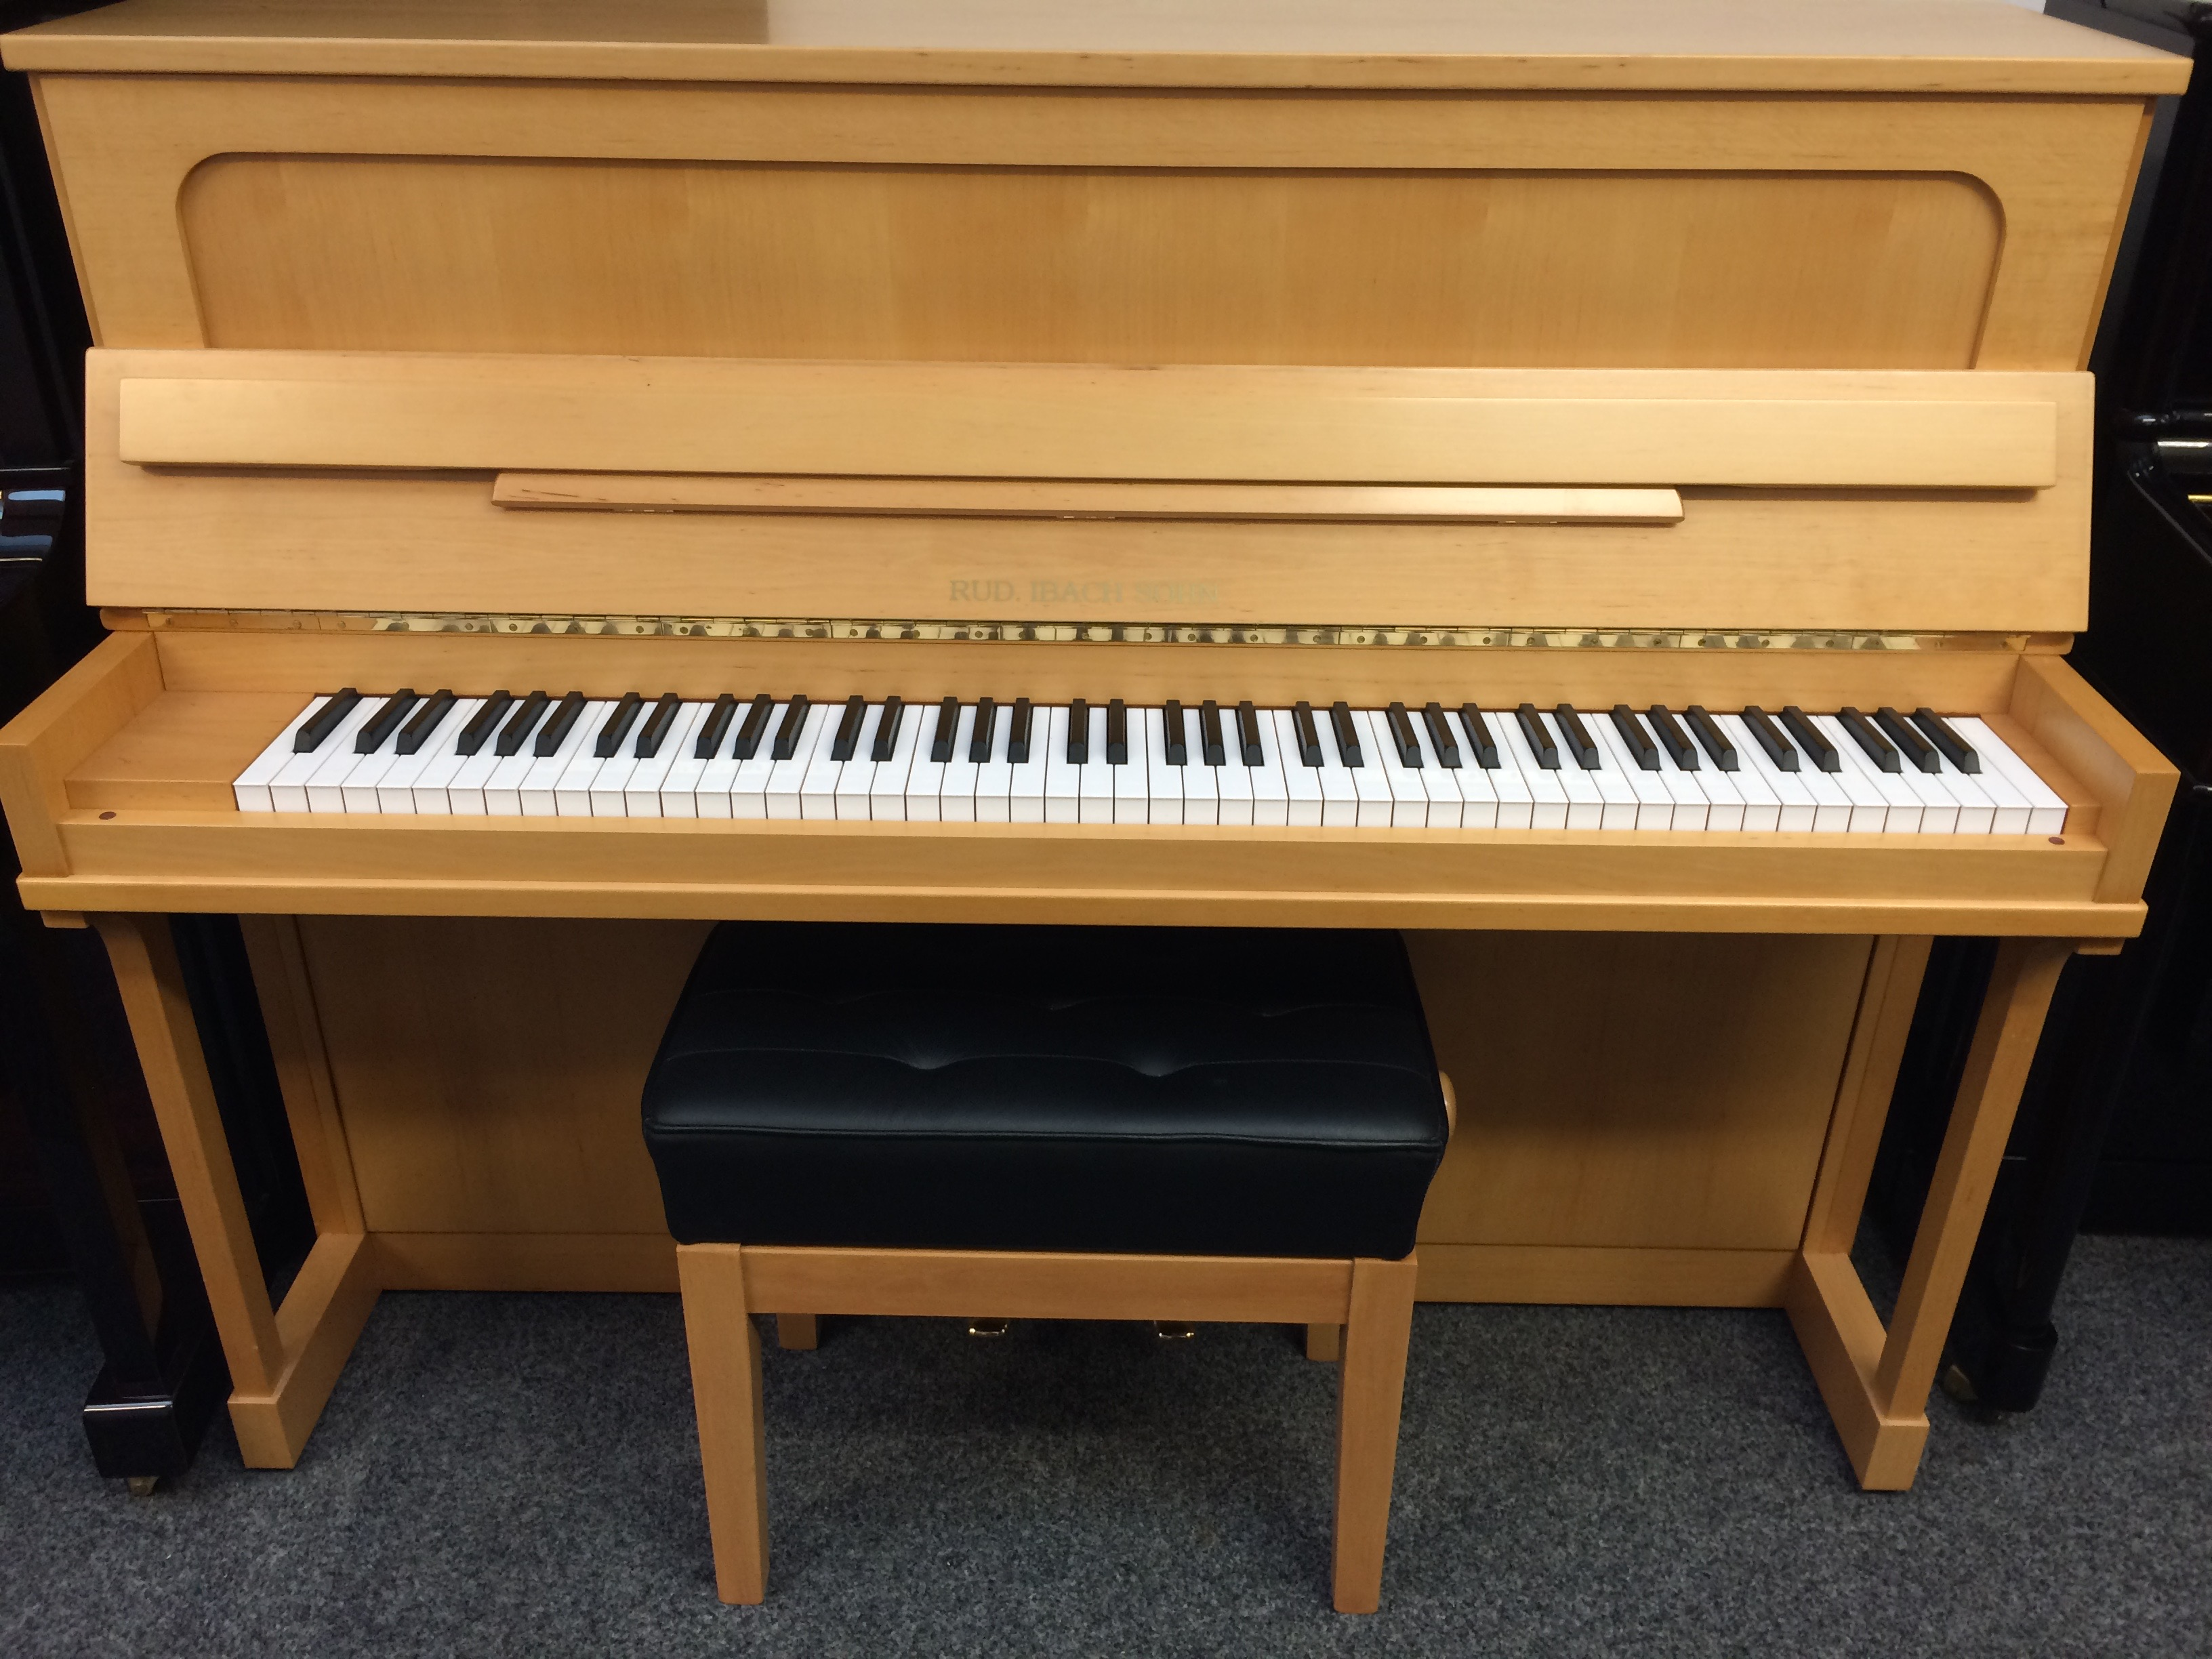
Why No Instrument?
Too expensive, can’t afford one?
Too cranky, don’t like the sound?
No one with the ability to play?
Our quirky, eccentric doctrine?
Don’t believe in music?
A craving to be different?
Just want to be argumentative?

Slide 3
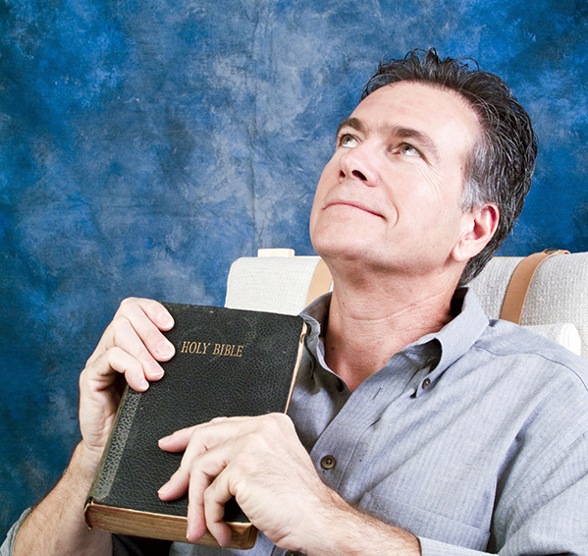
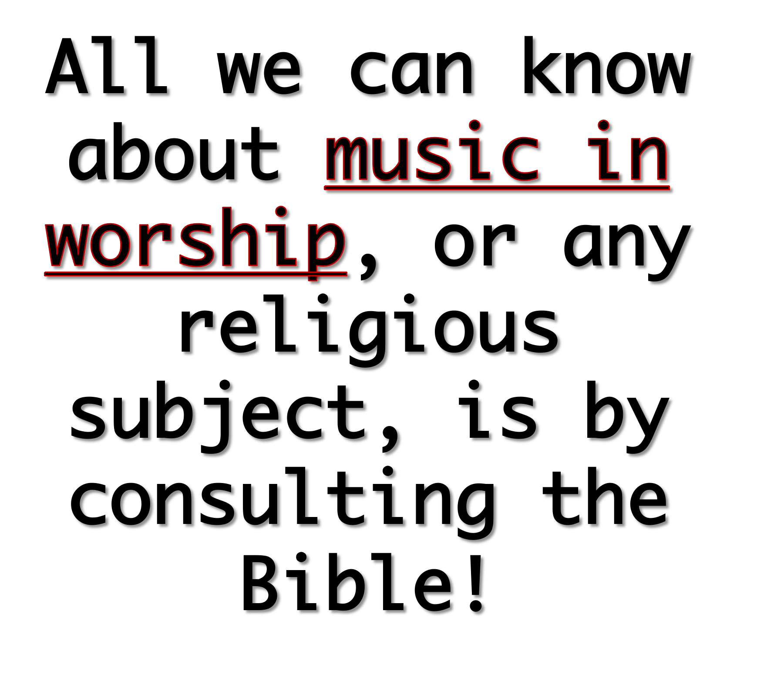
You do Realize…

Slide 4
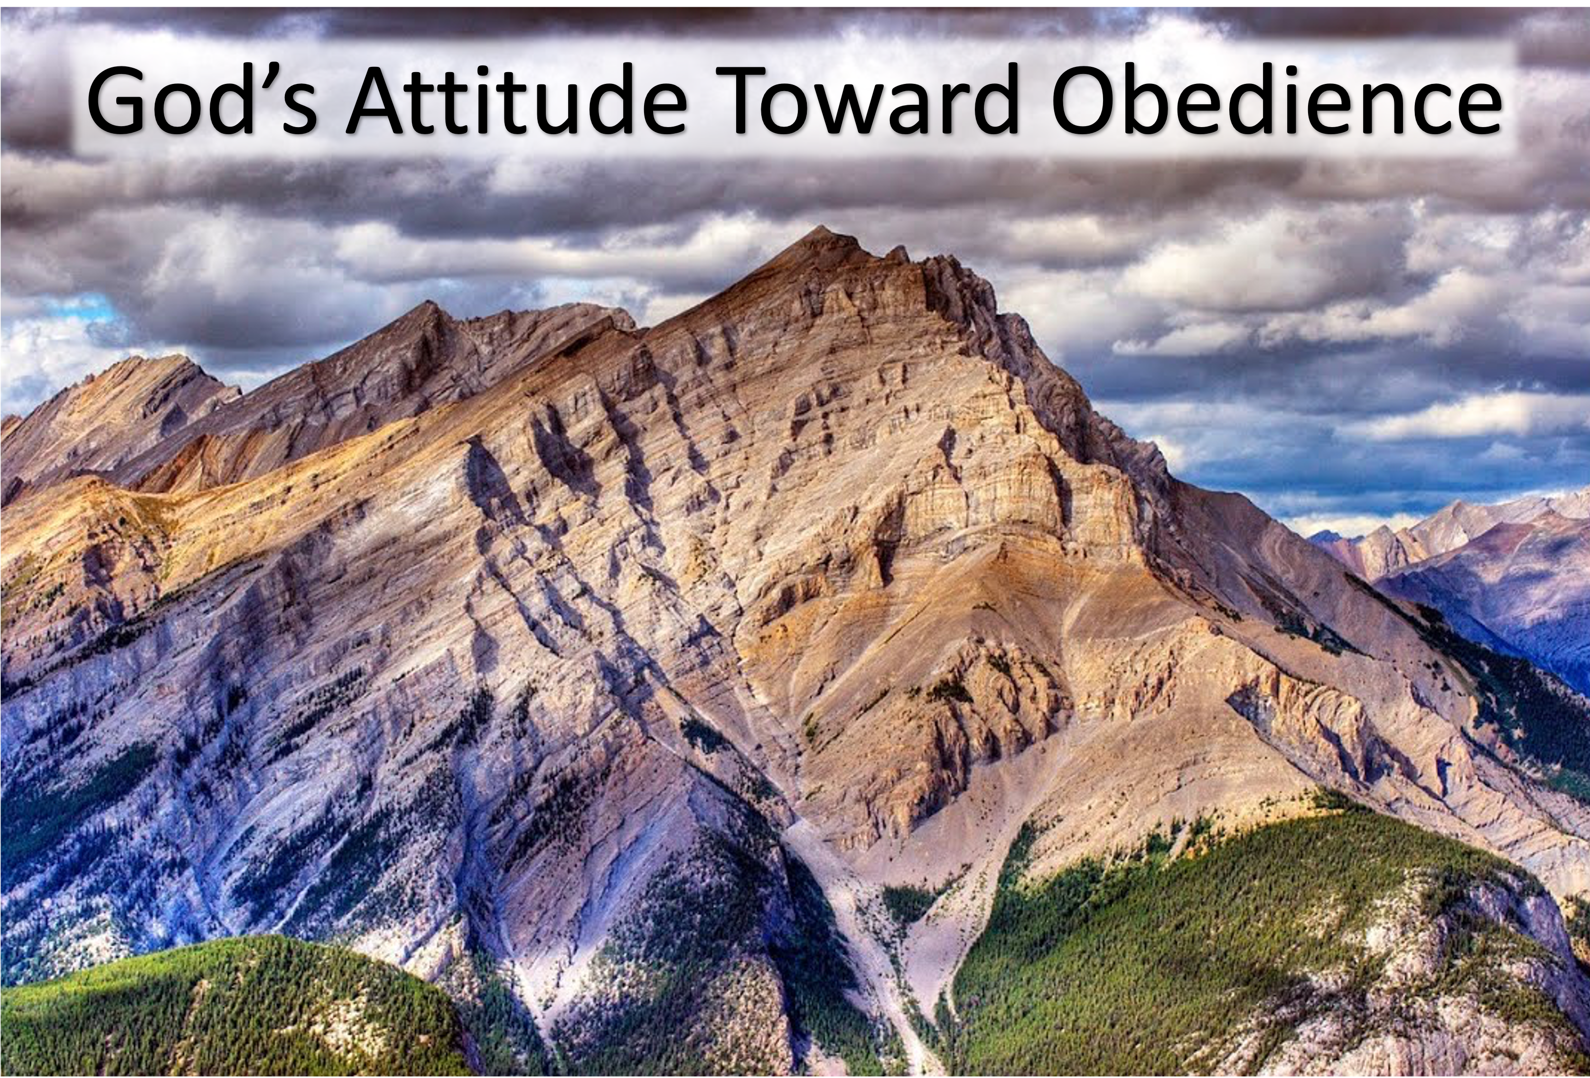
Cain (Genesis 4:3-5). Cain disobeyed God and his worship was rejected!
Nadab & Abihu (Leviticus 10:1-2 ). These men disobeyed God and were destroyed by fire!
King Saul (1 Samuel 15:15, 22). Saul disobeyed God and lost his kingdom!
Jesus Christ (Hebrews 5:8-9). The Son of God was obedient in all things and we can do no less!
Christians (Matthew 28:18-20). Faithfulness to Christ, is observing (obeying) all His authoritative commands.

Slide 5
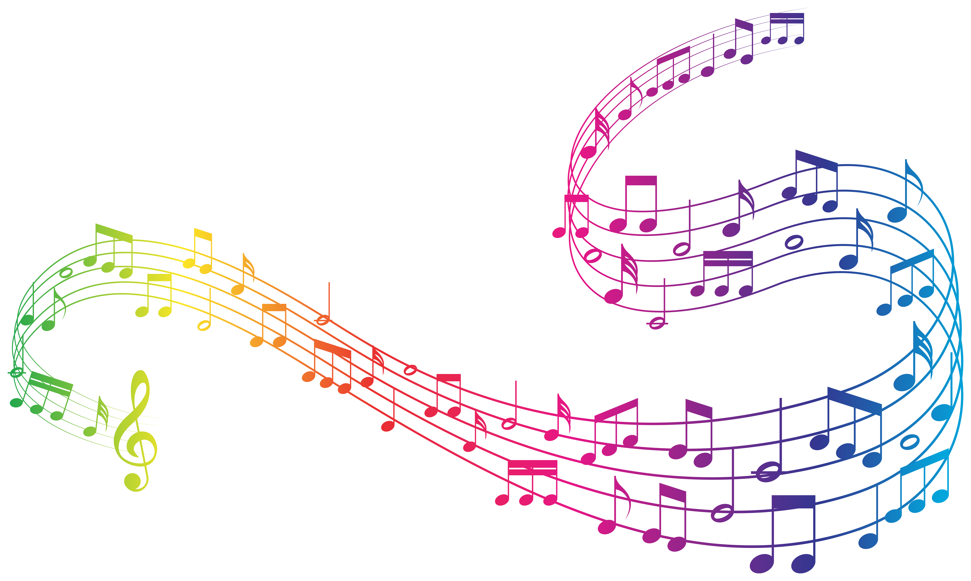

Definition of music
1a : vocal, instrumental, or mechanical sounds having rhythm, melody, or harmony

Slide 6
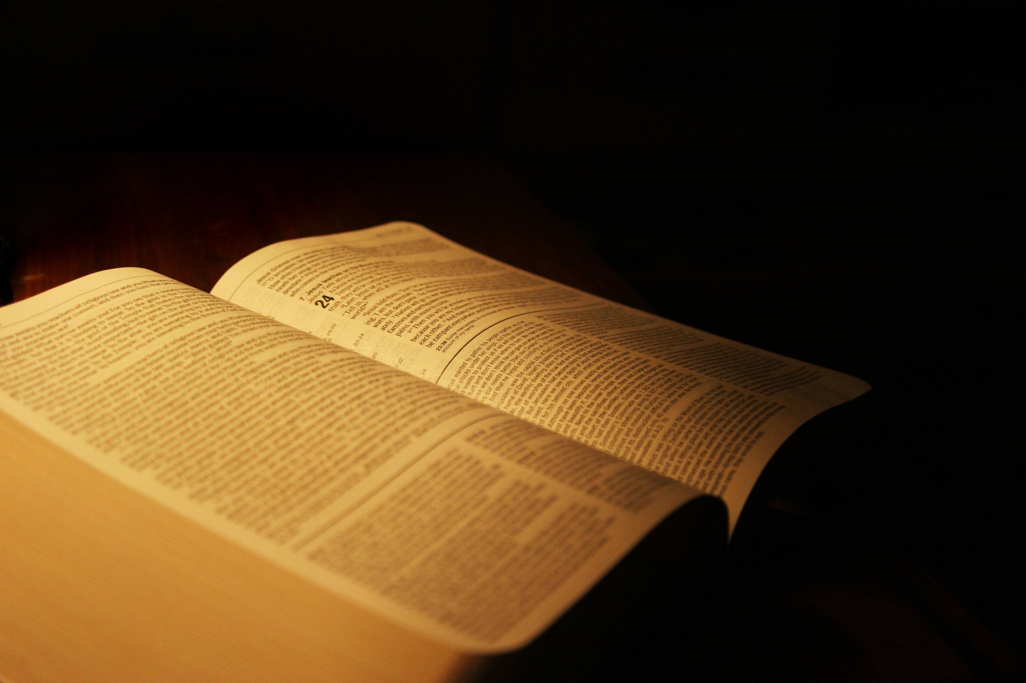


Slide 7
Matthew 26:30
Acts 16:25
Romans 15:9
1 Corinthians 14:15
Ephesians 5:19
Colossians 3:16
Hebrews 2:12
James 5:13
That’s it!

Slide 8

Who? “All Christians” (not choirs, groups, solos).
Kind? “Vocal” (Sing, not play).
How? “Sincerely” (Engage the mind and the mouth).
What? “P / H / SS” (Not country, rock, Hip Hop).
…speaking to one another in psalms and hymns and spiritual songs, singing and making melody in your heart to the Lord,
Ephesians 5:19

Slide 9
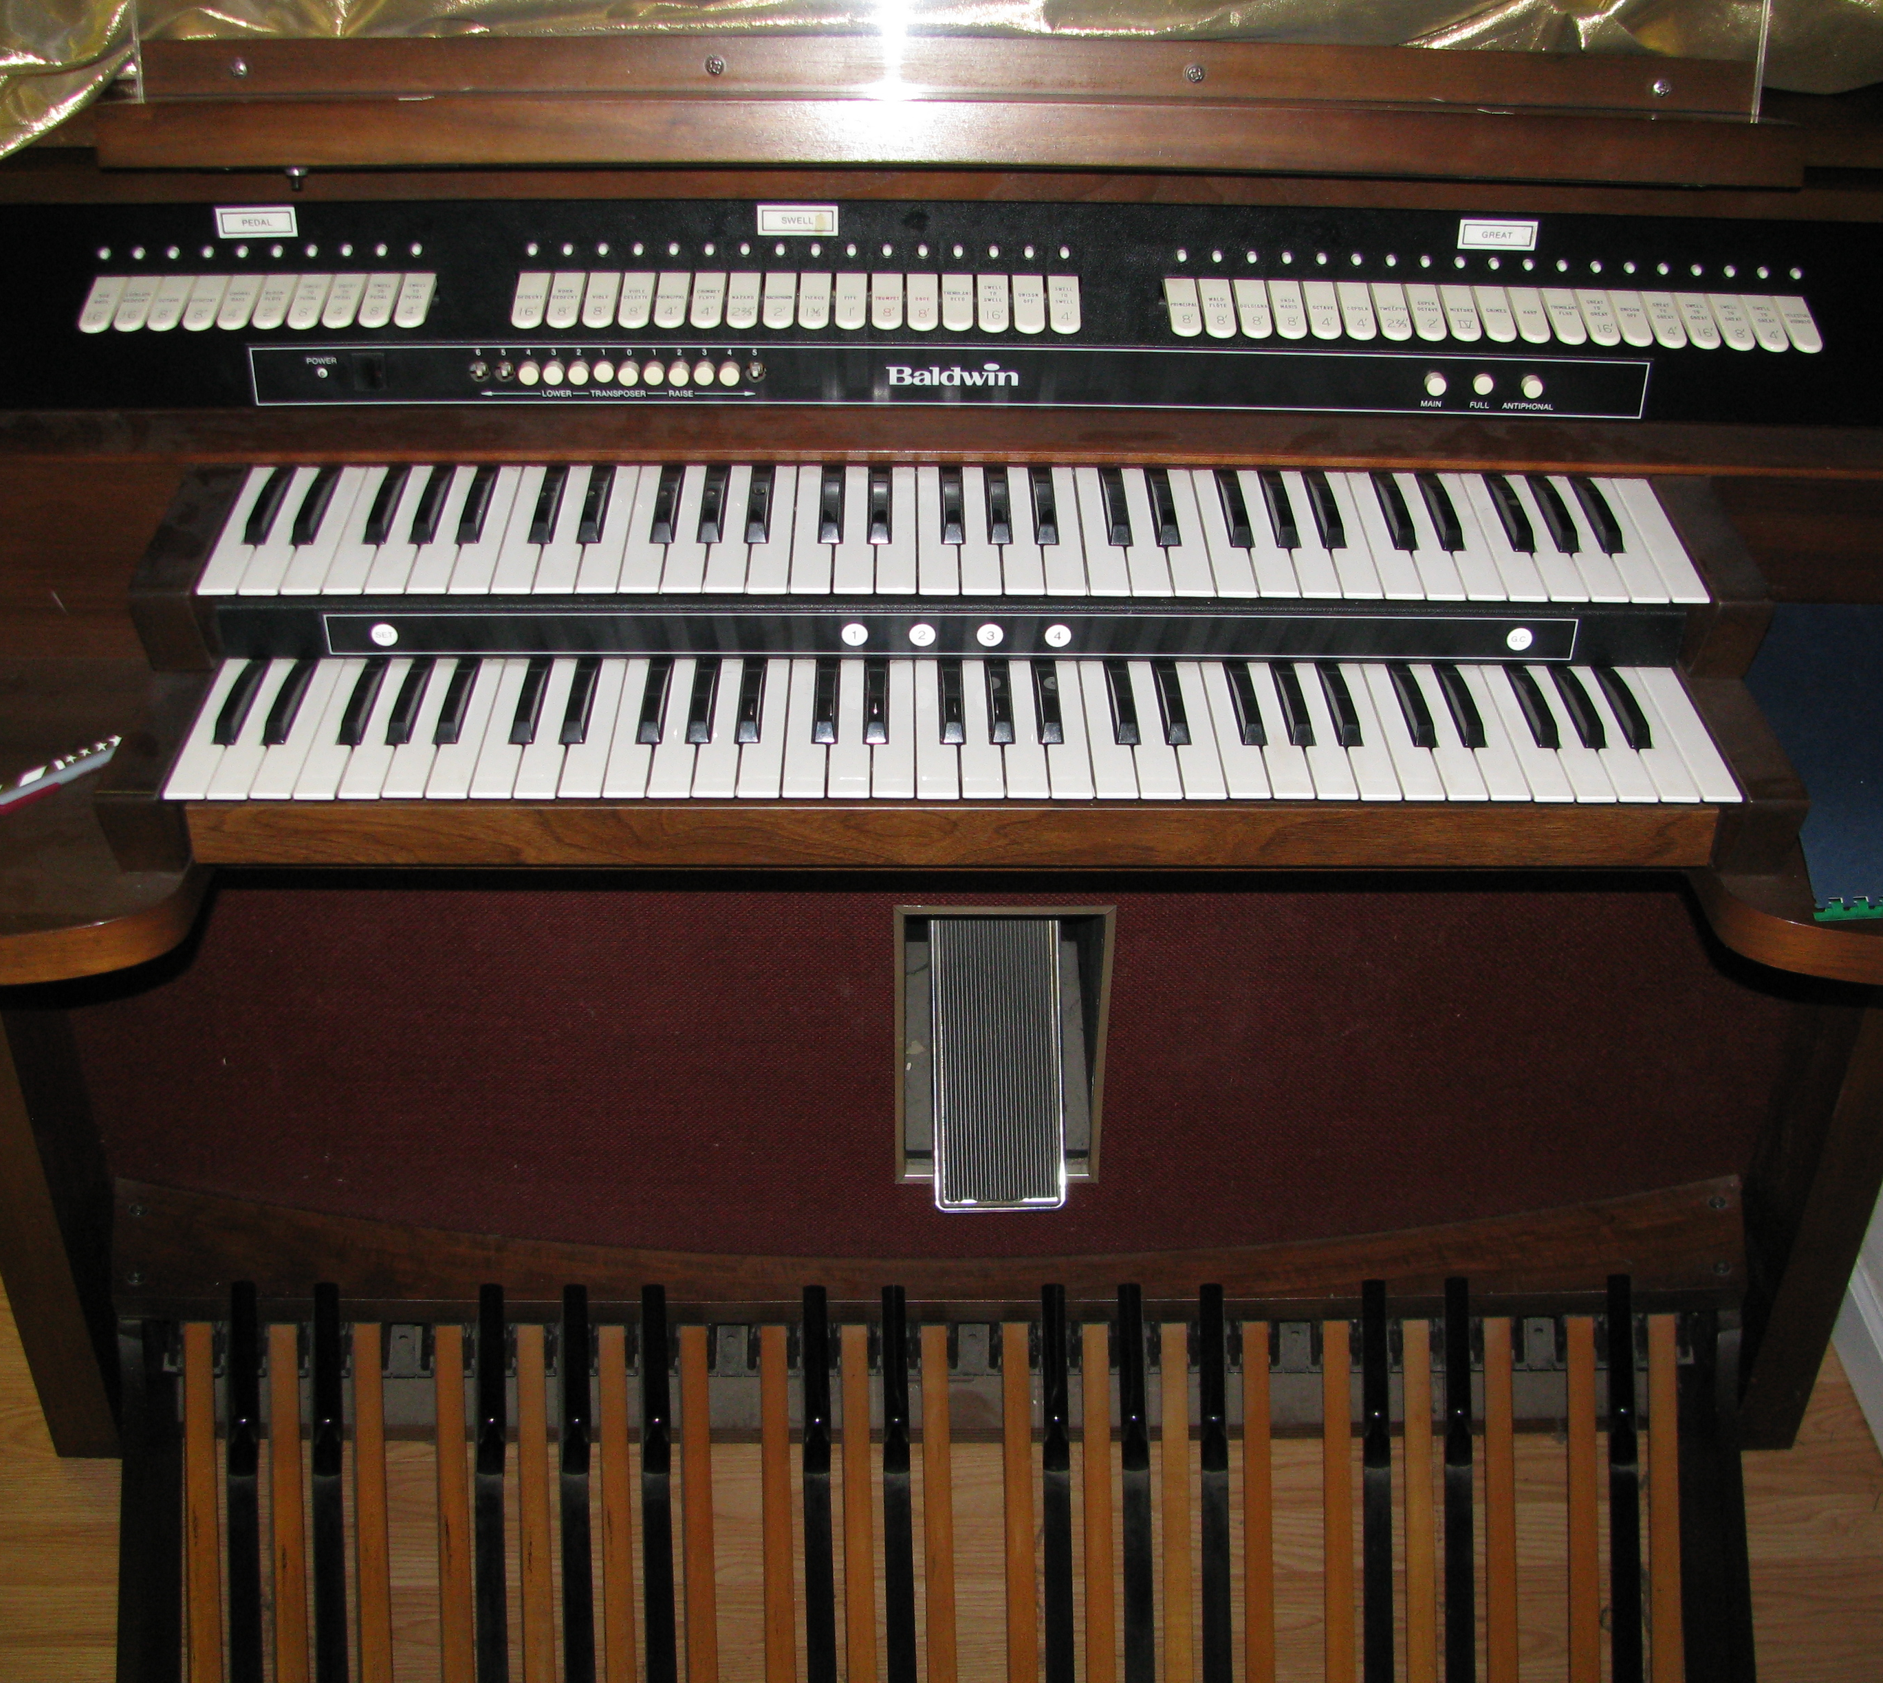
What others have said about
Instruments in Worship
“Musical instruments in the celebration of praises of God would be no more suitable than the burning of incense, the lighting of lamps, and the restoration of other shadows of the Law… Men who are fond of outward pomp may delight in the noise.”
John Calvin
“For years the Baptists fought the introduction of instrumental music into the churches… Installation of the organ brought serious difficulties in many churches.”
The Baptist Church in the Lower Mississippi Valley 1776-1845
Walter Brownlow Posey
“I have no objection to instruments of music in our chapels, provided they are neither seen nor heard.”
John Wesley
“An organ in the worship of God is an ensign (badge) of Baal.”
Martin Luther
“I’d as soon pray to God with machinery as to sing to God with machinery.”
Charles Spurgeon

Slide 10
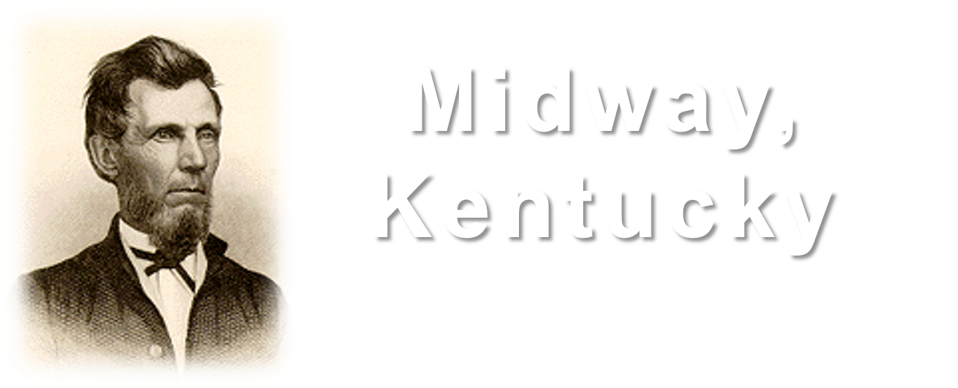
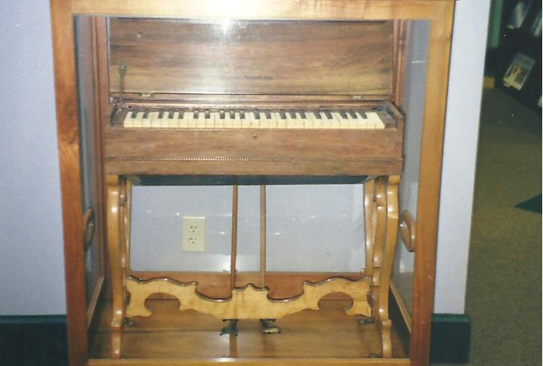

The Instrument in churches of Christ
L. L. Pinkerton introduced this melodeon into worship. It caused so much trouble in Midway that Adam Hibler, an elder of the church, removed the “instrument of Satan” from the church late one night with the assistance of a servant who passed it out to Hibler through an open window.

Slide 11
“…though He was a Son, yet He learned obedience by the things which He suffered. And having been perfected, He became the author of eternal salvation to all who obey Him…”
(Hebrews 5:8-9)

