Slide 1
How to Study the Bible

Slide 2
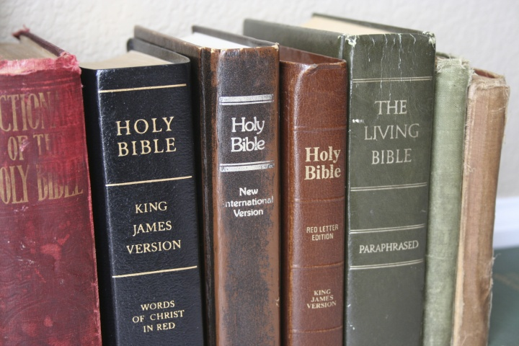
Why are there so many versions of the Bible?

Slide 3
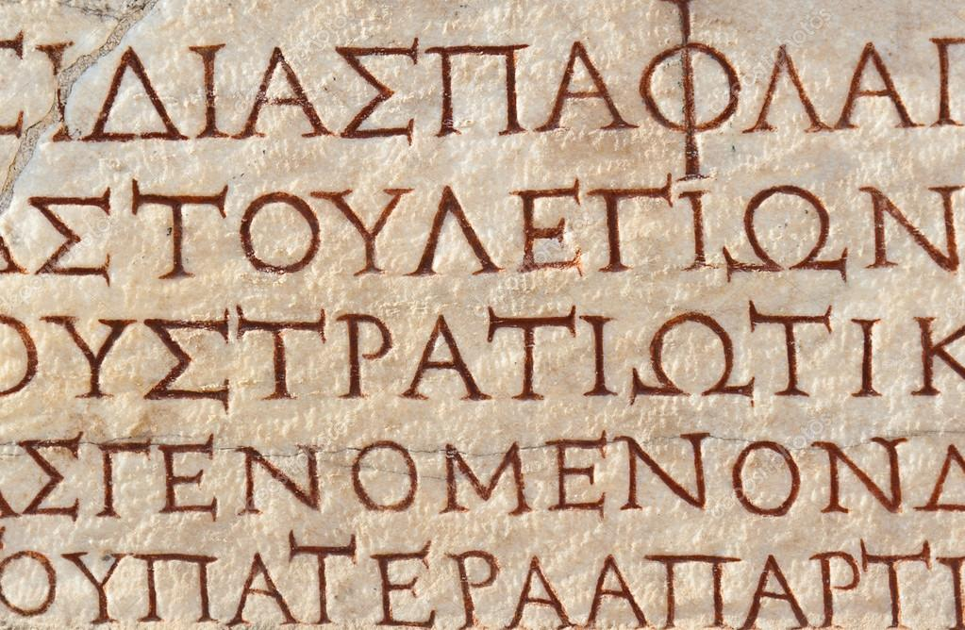
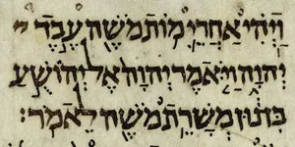
Original Bible Languages
Old Testament: Hebrew
New Testament: Greek
Some parts of the O.T. are written in Aramaic (Ezra 4:8—6:18, 7:12-26; Daniel 2:4—7:28).

Slide 4
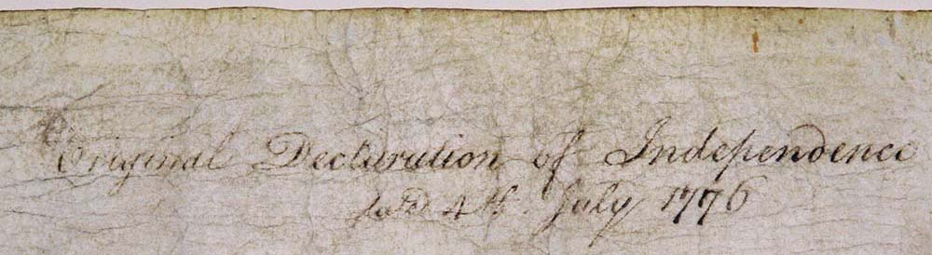
Autograph = original document
Original Declaration of Independence
date 4th July 1776
Ex. 34:28 – “he wrote on the tablets the words of the covenant, the Ten Commandments.”
Gal. 6:11 – “See with what large letters I am writing to you with my own hand.”

Slide 5
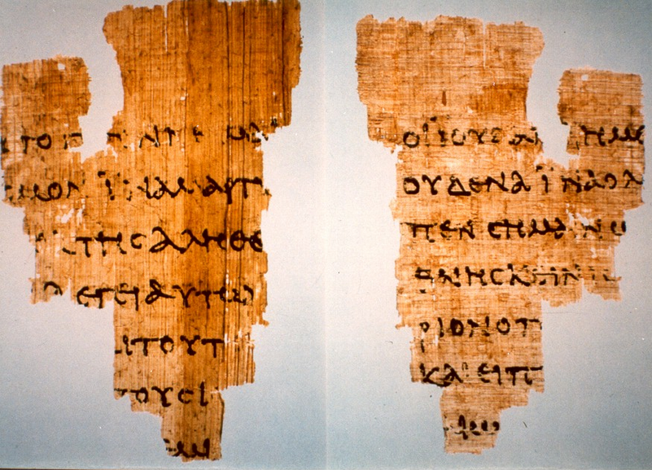
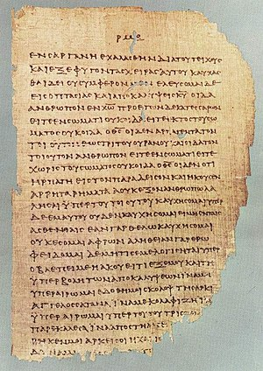
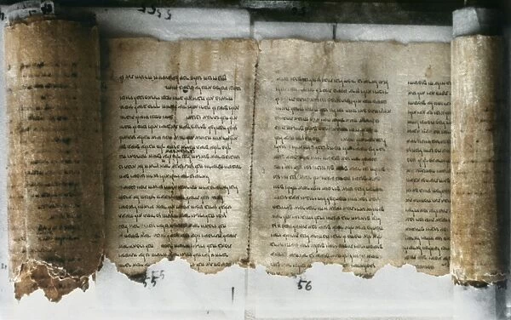
Manuscripts = copies of the original

Slide 6
Manuscripts = copies of the original
5800+ mss. of the Greek New Testament
some are closer to the original but fewer in number (Codex Sinaiticus, Vaticanus, Alexandrinus)
NASB
NIV
ESV
some are further from the original but greater in number (Majority Text)
KJV
NKJV

Slide 7
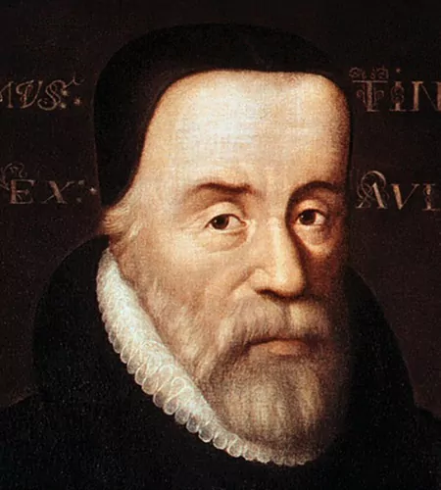
William Tyndale (1490-1536)
The Father of the English Bible
“If God spare my life ere many years, I will cause a boy that driveth ye plow shall know more of the Scripture than thou doest!”
translated the New Testament, Pentateuch, and Jonah into English
strangled to death, body burned at the stake

Slide 8
List special projects including field trips, organized by the school year calendar

Slide 10
more literal
more readable
WORD for WORD
THOUGHT for THOUGHT
PARA-PHRASE
NASB
ESV
KJV
NKJV
NIV
GNT
TLB
MSG

Slide 11
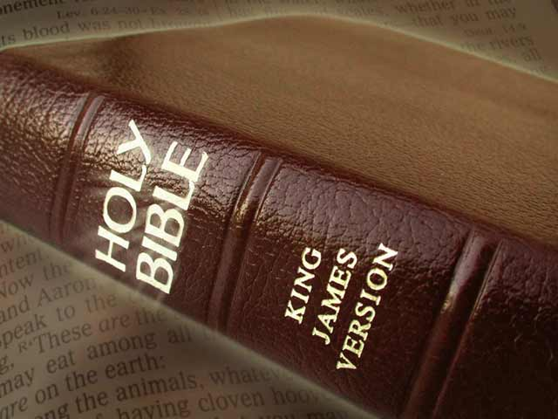
King James Version (1611)
later editions: 1629, 1638, 1762, 1769
thee, thou, thine
“suffer little children to come unto Me” (Lk. 18:16)
“superfluity of naughtiness” (Jas. 1:21)
“Easter” (Acts 12:4)
“Lucifer” (Isa. 14:12)
12th grade reading level

Slide 12
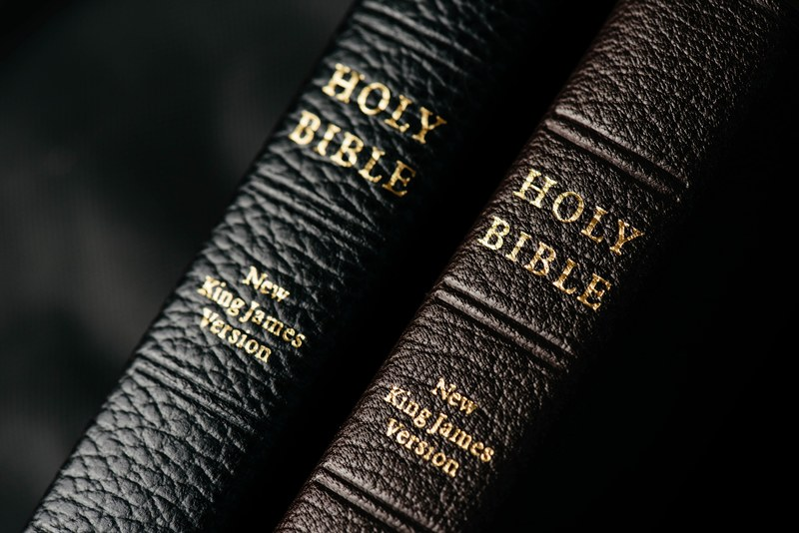
New King James Version (1982)
“lovest thou me” “do you love Me” (Jn. 21:15)?
Holy Ghost Holy Spirit
“fetched a compass” “circled around” (Acts 28:13)
“conversation” “conduct” (Phil. 1:27)
Elias Elijah
Jeremy Jeremiah
Esaias Isaiah
7th grade reading level

Slide 13
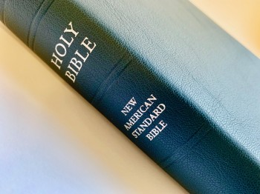
New American Standard Bible (1977)
later editions: 1995, 2020
Jehovah Lord
thou/thine you/your, except when addressing Deity
considered the most literal of modern translations
11th grade reading level

Slide 14
New International Version (1978)
later editions: 1984, 2011
“thought for thought,” easier to read
furlongs miles
shekels dollars
leaven yeast
“sinful nature” (Rom. 7:18,25)
“I was sinful at birth” (Psa. 51:5)
8th grade reading level

Slide 15
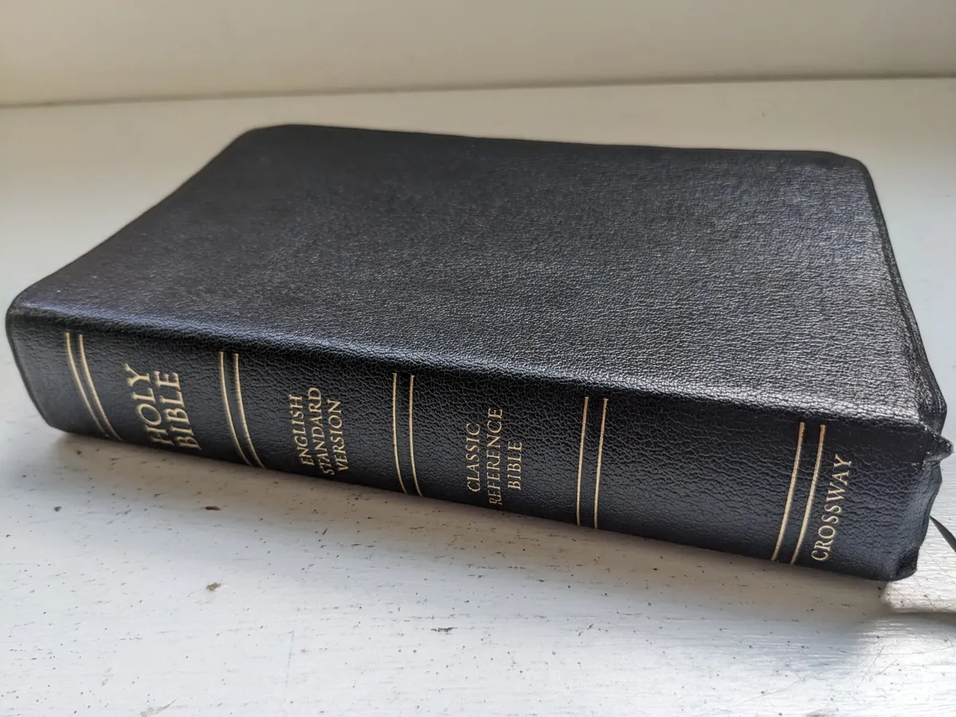
English Standard Version (2001)
literal, but designed to be more readable
rejects use of gender-neutral language of modern translations
uses inclusive words when original does not demand a specific gender
“let your light shine before others” (Mt. 5:16)
10th grade reading level

Slide 16
Which version should I use?

