Slide 1
Is the Bible Reliable?

Slide 2
This question is not new.
“that you may not be quickly shaken from your composure or be disturbed either by a spirit or a message or a letter as if from us, to the effect that the day of the Lord has come” (2 Thess. 2:2).

Slide 3
How do you know that you have ALL of the inspired writings?

Slide 4
The Bible tells us we do not.
Acts 2:40 – “And with many other words he solemnly testified and kept on exhorting them…”
1 Cor. 5:9 – “I wrote you in my letter…”
Col. 4:16 – “Read my letter that is coming from Laodicea.”

Slide 5
The Claims of Inspiration
2 Tim. 3:16 – “All Scripture is inspired by God” and equips us for “every good work.”
2 Pet. 1:3 – “granted to us everything pertaining to life and godliness”
Jude 3 – “the faith which was once for all delivered to the saints.”

Slide 6
The Claims of Inspiration
1 Tim. 5:18– “For the Scripture says, ‘You shall not muzzle the ox while he is threshing,’ and ‘The laborer is worthy of his wages.’”
Deut. 25:4
Luke 10:7
SCRIPTURE

Slide 7
What about all of the contradictions and errors in the Bible?

Slide 8
Autograph = original document
1 Cor. 16:21 – “This greeting is in my own hand – Paul.”
Col. 4:18 – “I, Paul, write this greeting with my own hand.”
Phile. 19 – “I, Paul, am writing this with my own hand.”

Slide 9
Manuscript = copy of original
Ancient Literature | # of MSS | Earliest MSS to Autograph
Livy’s History of Rome | 150 | 400 years
Caesar’s Gallic Wars | 251 | 950 years
Tacitus’ Annals | 51 | 750-950 years
Homer’s Illiad | 1800 | 400 years
Greek New Testament

Slide 10
Manuscript = copy of original
Ancient Literature | # of MSS | Earliest MSS to Autograph
Livy’s History of Rome | 150 | 400 years
Caesar’s Gallic Wars | 251 | 950 years
Tacitus’ Annals | 51 | 750-950 years
Homer’s Illiad | 1800 | 400 years
Greek New Testament | 5838 | 50 years

Slide 11
“Significant” Variations
MANUSCRIPT 1
MANUSCRIPT 2
Phil. 1:14 – “to speak the word”
2 Tim. 2:14 – “before God”
Titus 1:10 – “many who are insubordinate”
2 Thess. 2:9 – “whom the Lord will destroy”
“to speak the word of God”
“before the Lord”
“many who are also insubordinate”
“whom the Lord Jesus will destroy”

Slide 12
Most significant variations
Acts 8:37 – many mss. do not contain this v.
Mark 16:9-20 – some of the oldest mss. do not contain vss. 9-20

Slide 13
Is there any evidence outside of the Bible to support its claims?

Slide 14
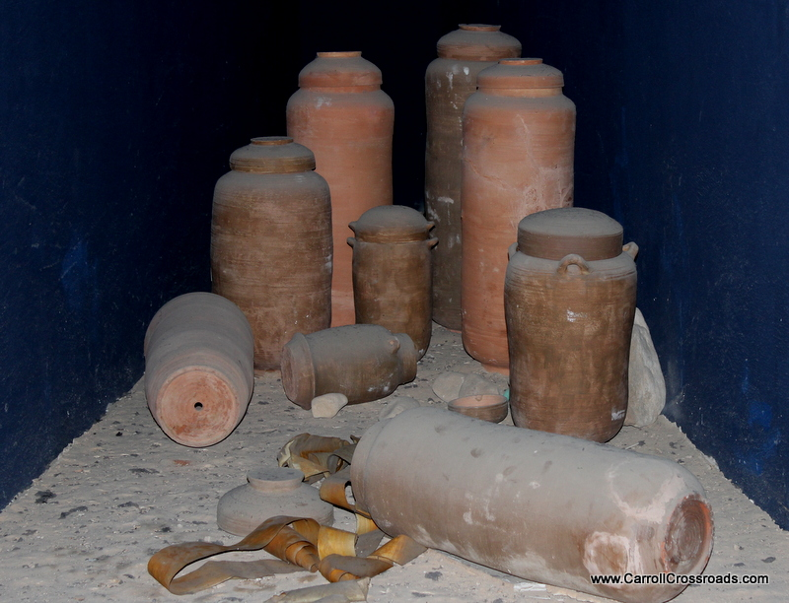
The Dead Sea Scrolls
Discovered in 1947 in caves by Dead Sea
Over 200 O.T. mss., every book except Esther
Copied 250 B.C. – 50 A.D. by the Essenes

Slide 15
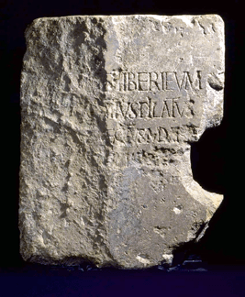
The Pilate Stone
Discovered in 1961 in Caesarea
Part of a theatre built in honor of Tiberius
Dedicated by “Pontius Pilate, Prefect of Judea”

Slide 16
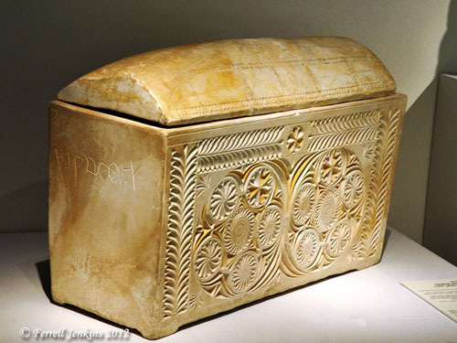
The Caiaphas Ossuary
Found in Jerusalem in 1990
Contains bones of a 60 year old man
Inscription: “Joseph son of Caiaphas”

Slide 17
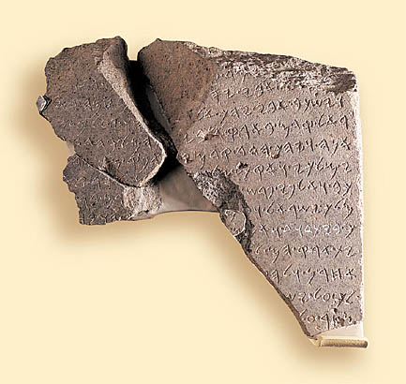
The House of David
Found in 1993 in northern Israel
Commemorates the victory of a king of Aram over two kings: “the king of Israel” and the son “of the House of David”

Slide 18
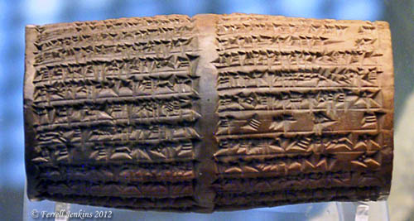
The Nabonidus Cylinder
Found in 1881 in Iraq
The king mentions “Belshazzar, the eldest son – my offspring”
cf. Dan. 5:16

Slide 19
Is the Bible Reliable?

Slide 20
“Last eve I passed beside the blacksmith’s door,
And heard the anvil ring the vesper chime;
Then looking in, I saw upon the floor,
Old hammers, worn with beating years of time.

Slide 21
‘How many anvils have you had,’ said I,
‘To wear and batter all these hammers so?’
‘Just one,’ said he, and then with twinkling eye,
‘The anvil wears the hammers out, you know.’

Slide 22
And so, I thought, the anvil of God’s Word
For ages skeptic blows have beat upon;
Yet, though the noise of falling blows was heard,
The anvil is unharmed – the hammers gone.”

