Slide 1
Lecture by Dr. Bo Kirkwood
Evolution
Creation
Bible Evidences

Slide 2
Job 38

Slide 3
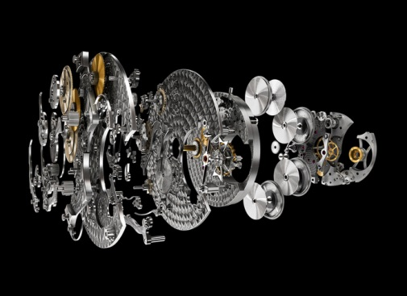
Two Powerful Proofs for Creation
Irreducible
Complexity
The Cambrian
Explosion

Slide 4
NeoDarwinism
“microevolutionary” changes can
accumulate to produce macroevolution”
through mutations and natural election.

Slide 5
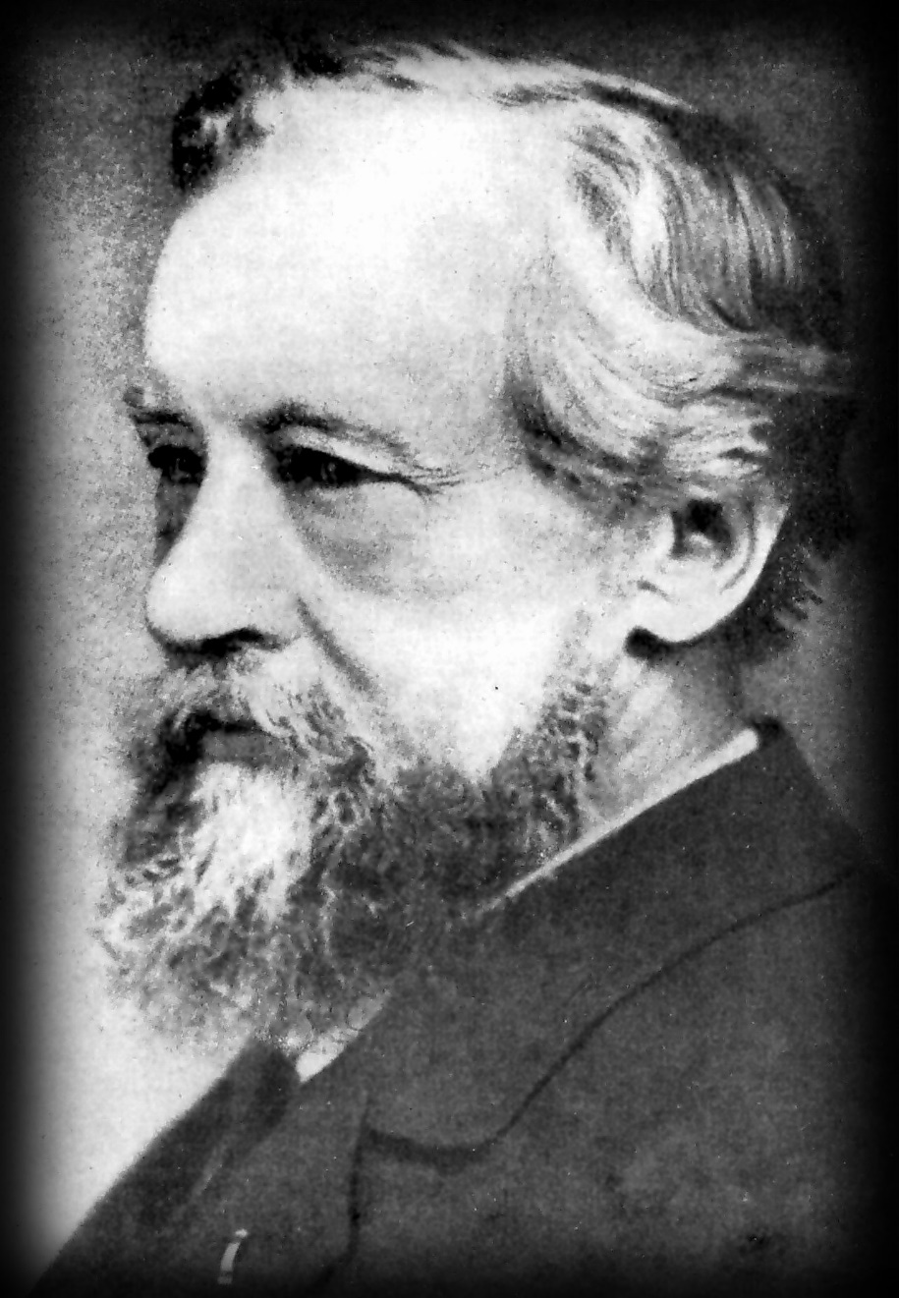
Gregor Mendel
Acquired characteristics were not incurred, disproved the concept of blending, and Limitations on the genetic variability available for natural selection.

Slide 6
1953
James Watson and Francis Crick
Crick postulated the
“sequence hypothesis”

Slide 7
Darwin’s
Black Box
1996 by Michael Behe

Slide 8
What is irreducible complexity?
By irreducibly complex, I mean a single system of several well-matched, interacting parts that contribute to the basic function, where the removal of any one of the parts causes the system to effectively cease to function.
Michael Behe

Slide 10
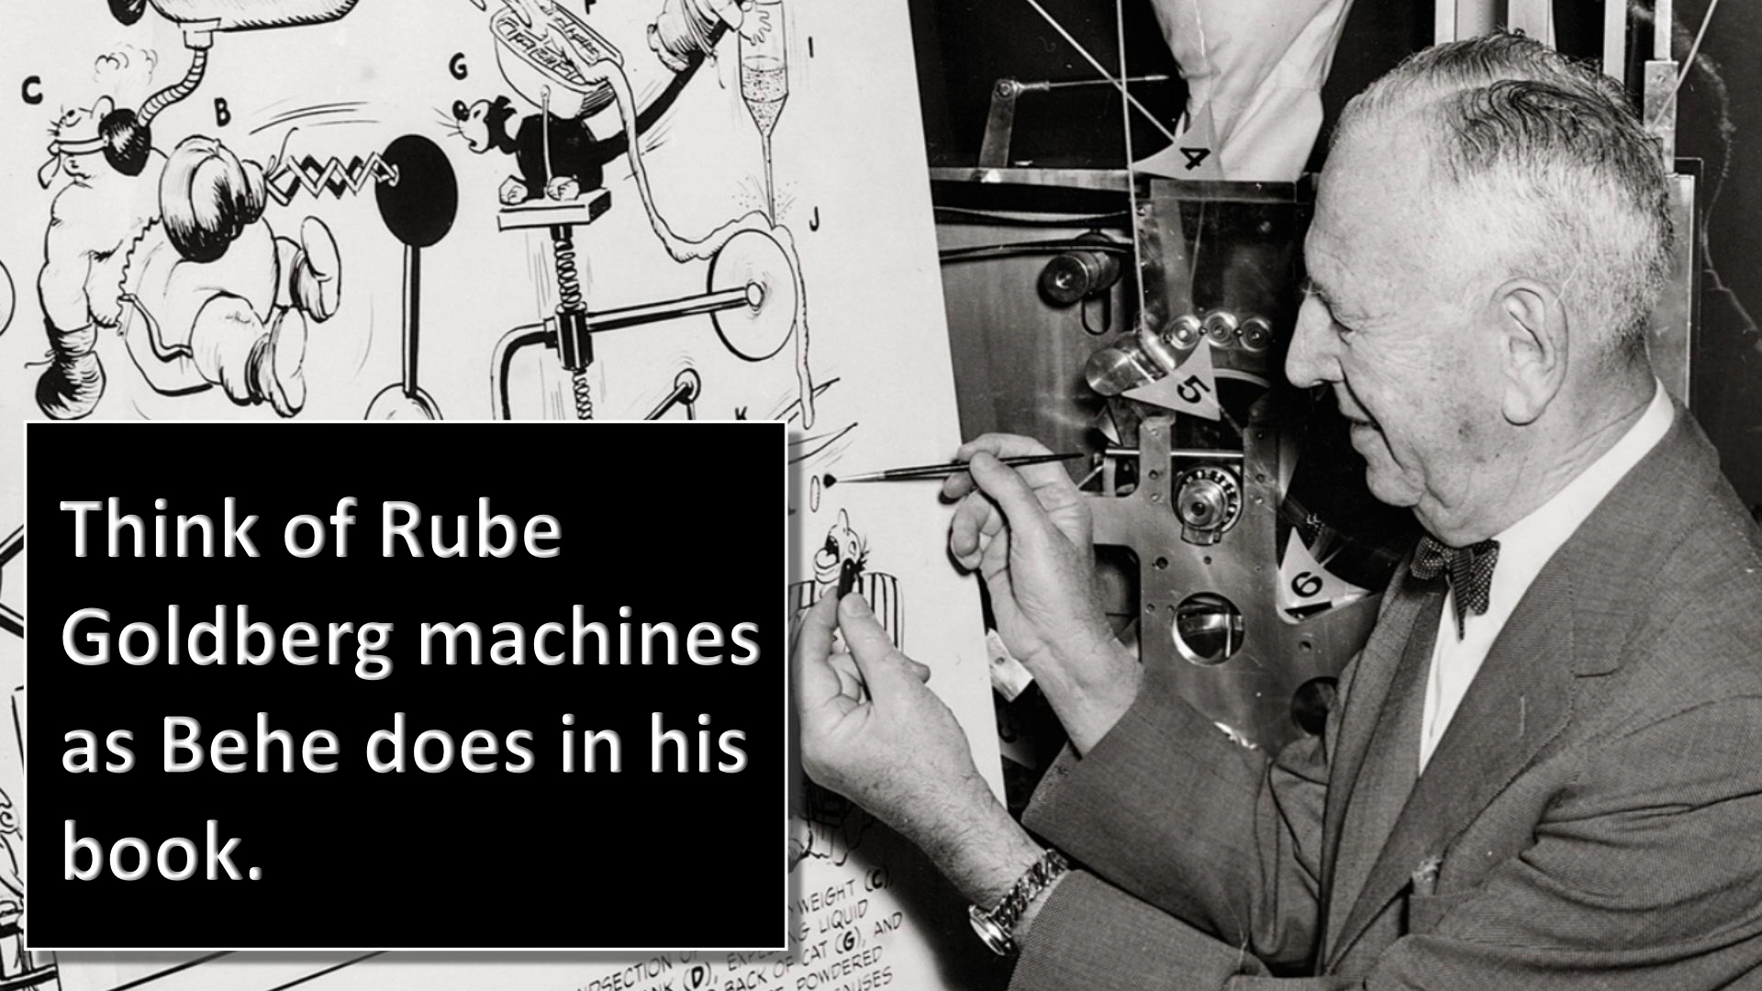

Slide 17
Cambrian Explosion

Slide 18
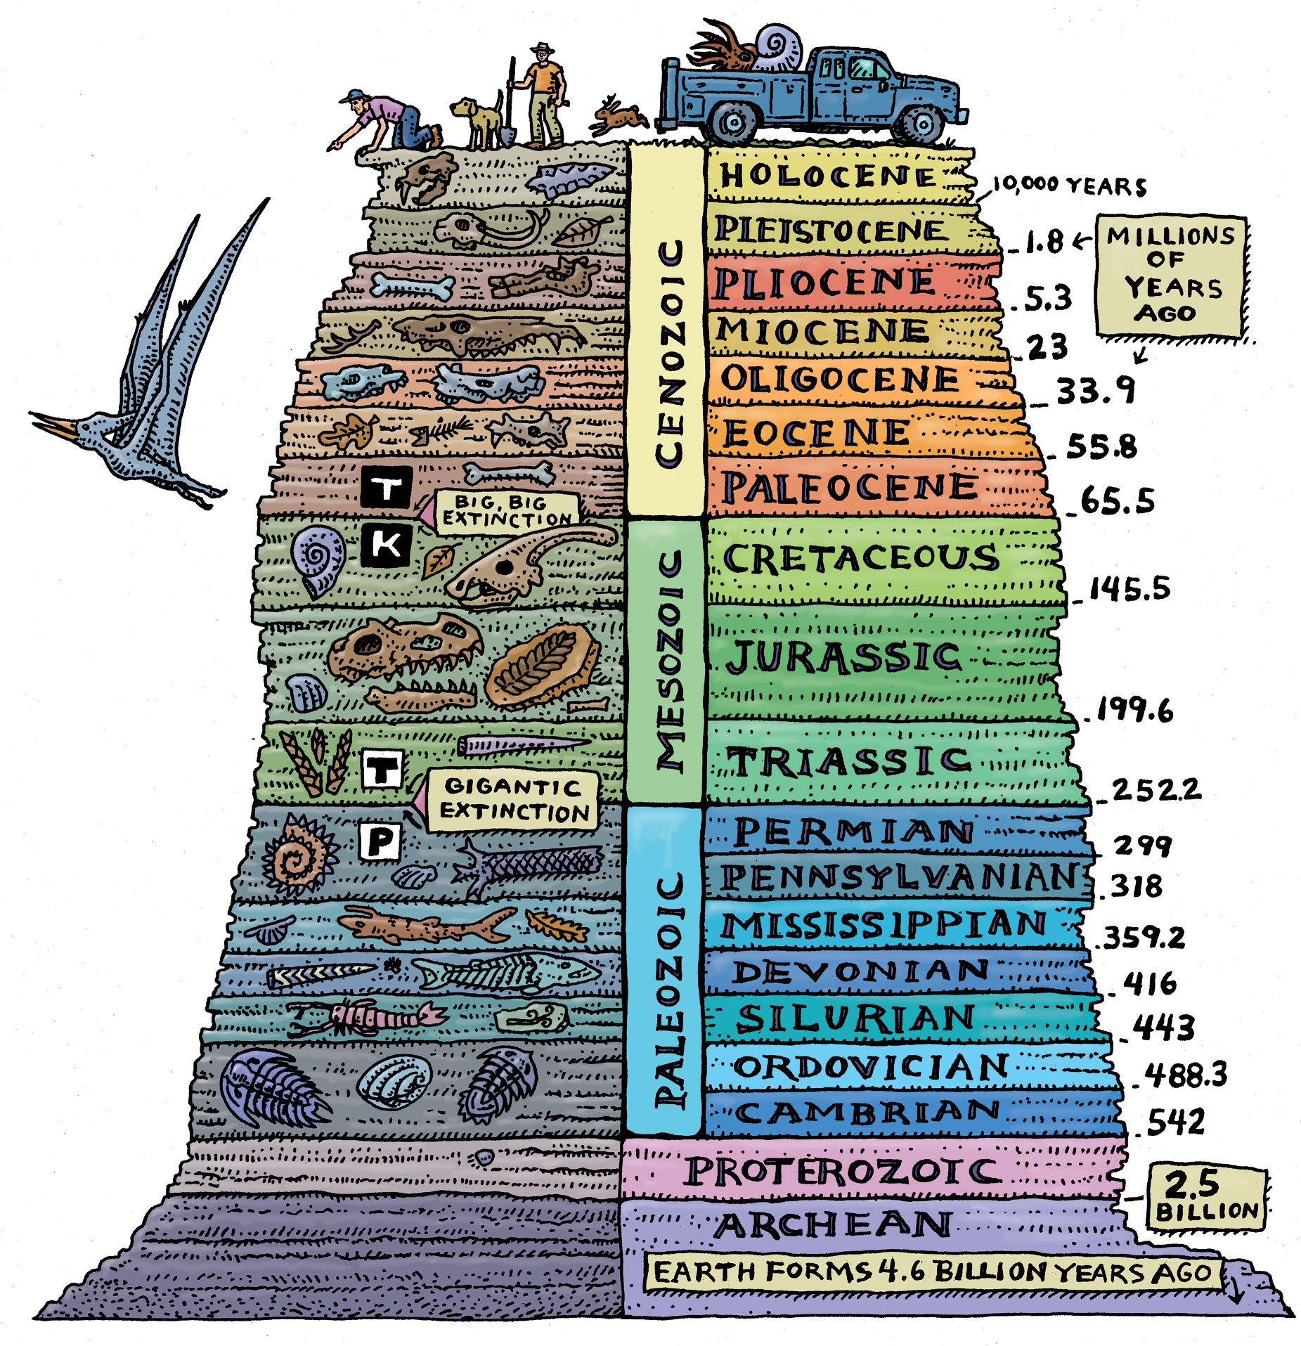
Geologic Column

Slide 19
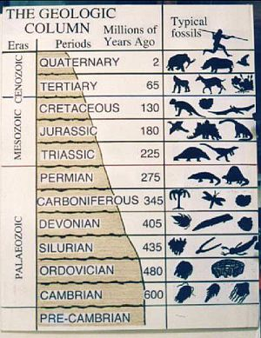
No where does the geologic column exists in it’s full thickness of at least 100 miles.

Slide 20
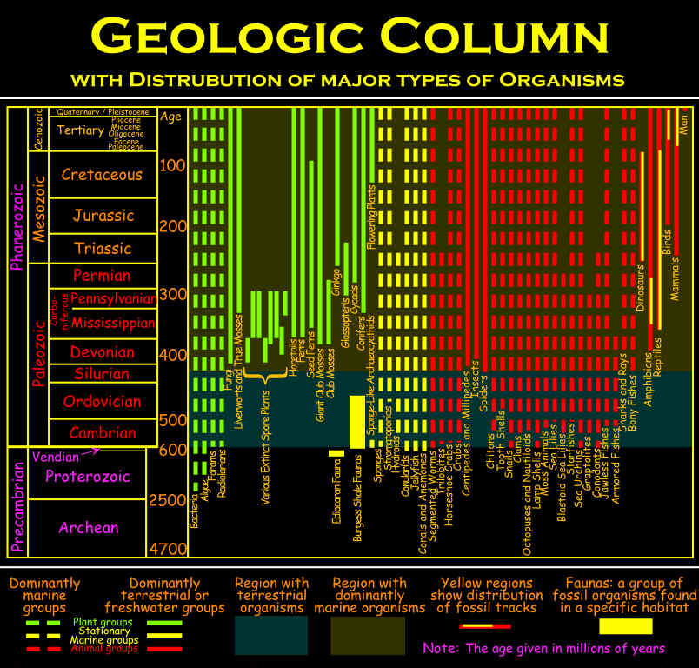
Clearly, the geologic column as depicted in most textbooks exists nowhere.

Slide 21
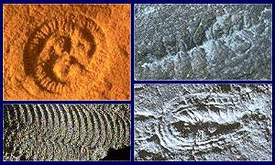
Pre-cambian animals have no obvious heads, sense organs, guts or eyes.

Slide 22
The Cambrian period animals offer significantly more complexity when compared to the Pre-Cambrian period.

Slide 23
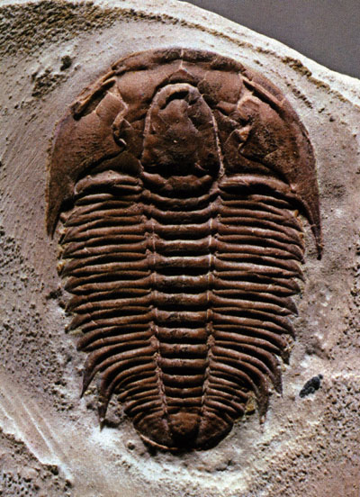
The most readily found is the trilobite.

Slide 24
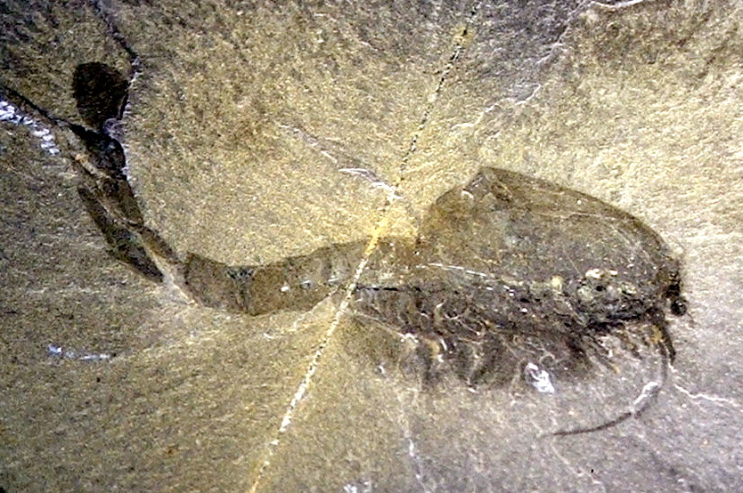
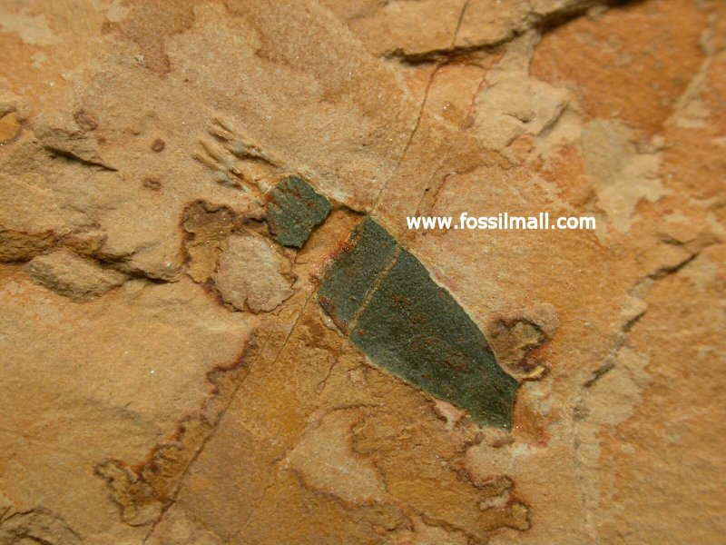
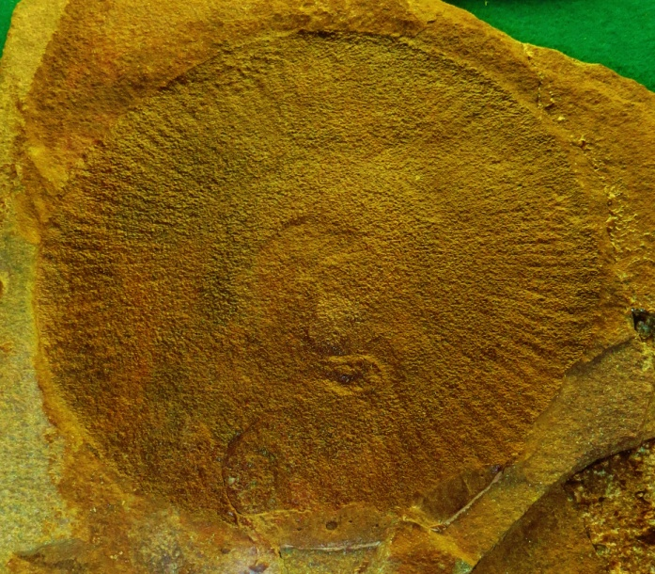
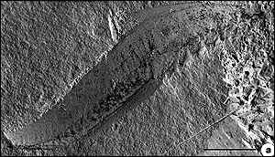
Waptia
Phoronida
Eldonia
Myllokunmingia fengjioa

Slide 25
So
what is
the problem?

Slide 26
Do Evolutionists admit a problem?

Slide 27
Every period demonstrates the same phenomenon; that is the abrupt appearance of complex organisms without transitional forms and this is paramount.

Slide 28
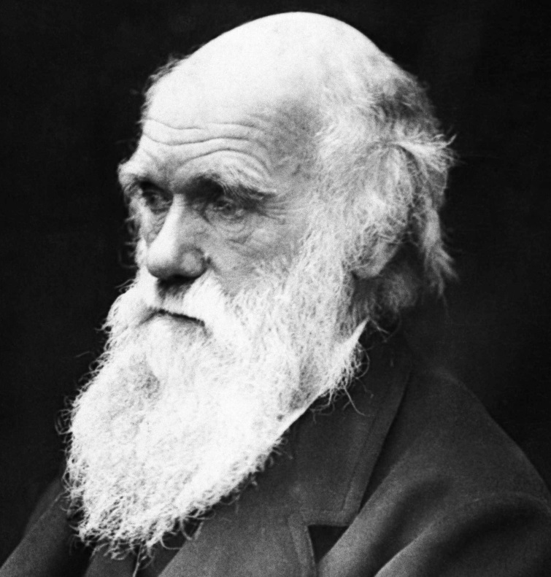
If numerous species, belonging to the same genera or families, have really started into life all at once, the fact would be fatal to the theory of descent with slow modification through natural selection.
Charles Darwin

Slide 29
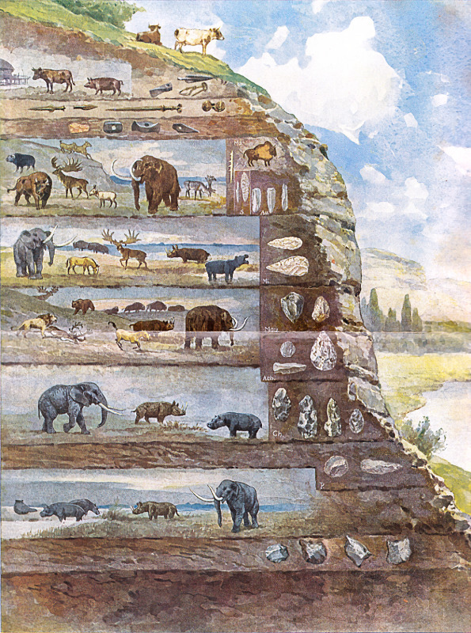
BUT
Evolutionists now disregard the fossil record.
The genome has sounded a death bell for creationists!

