Slide 1
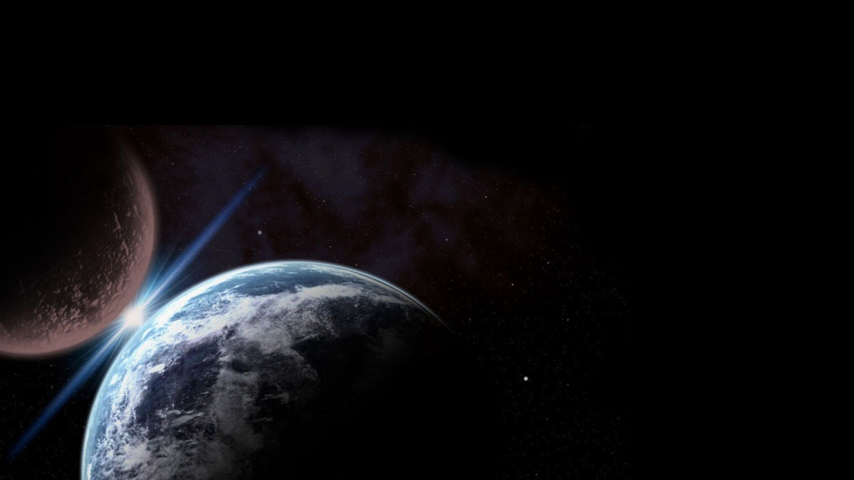
Lecture by Dr. Bo Kirkwood
Evolution
Creation
Bible Evidences

Slide 2
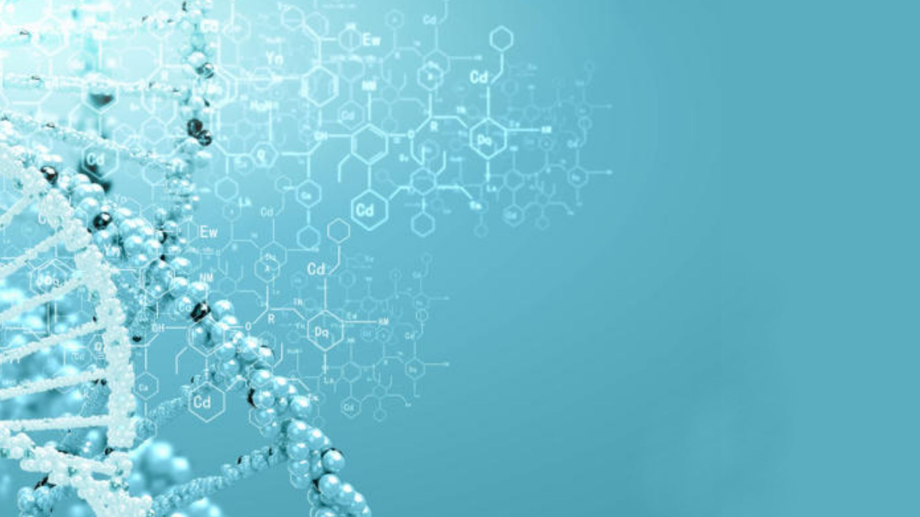
The Language of God
DNA

Slide 4
Then the Lord God formed man of dust from the ground, and breathed into his nostrils the breath of life; and man became a living being.
Gen. 2:7

Slide 5
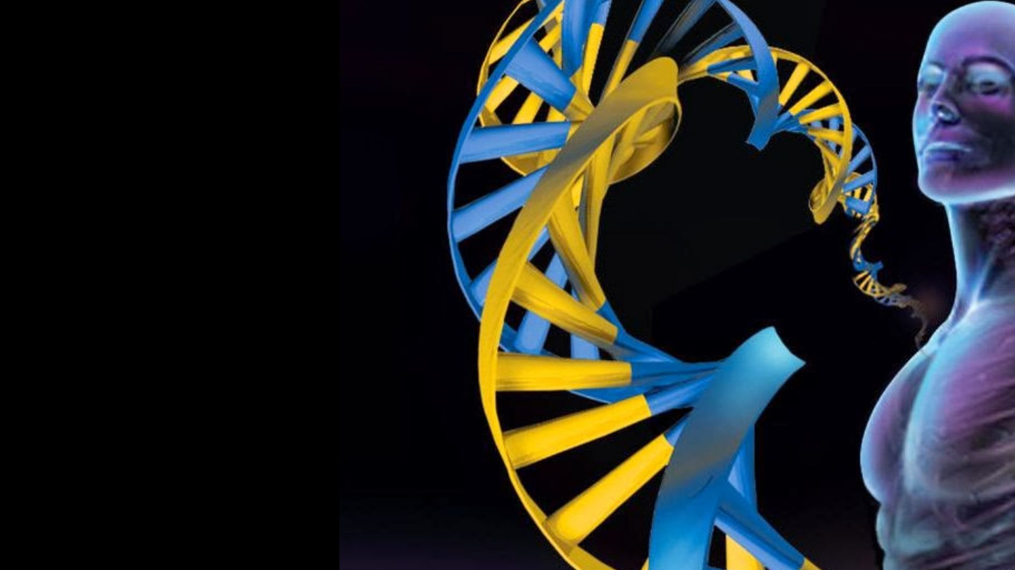
DNA discovered in 1953,
the human
genome
decoded
in 2003

Slide 8
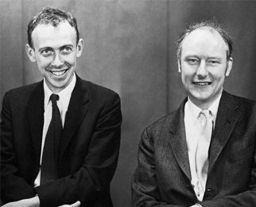
James Watson and Francis Crick
“discovered” the structure of
DNA in 1953

Slide 9
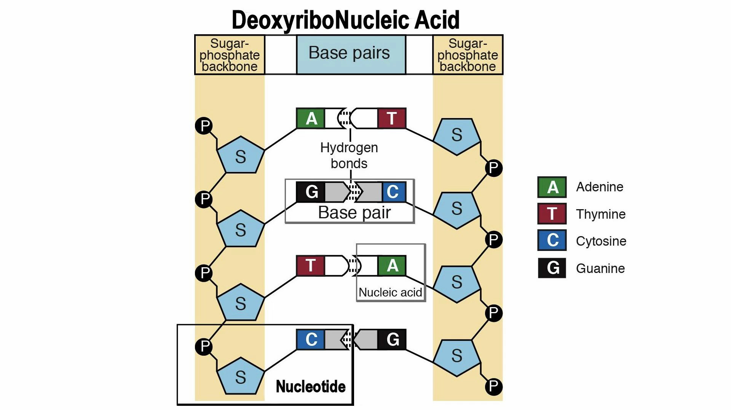

Slide 23
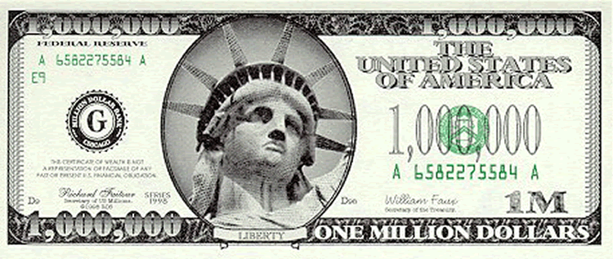
The million dollar question?
How did these digitally encoded and specifically sequenced instructions in DNA arise?

Slide 24
Complexity of DNA is found nowhere else in nature.
DNA must come from chance, law-like forces (necessity) or a combination of both per evolutionary doctrine.

Slide 25
Chance cannot “cause” anything and to use it as an explanation is to defer to ignorance!

Slide 26
The odds of a sequence of 6,000 characters is roughly the same as any other sequence of 6,000 characters but getting a pattern from order is an entirely different thing.

Slide 27
“Four score and seven years ago” and
“neney taw jill.gnmek.hdx _,”
same likelihood and both contain information (Shannon information); one has meaning and the latter not.
One suggests something other than chance and the other does not.

Slide 28
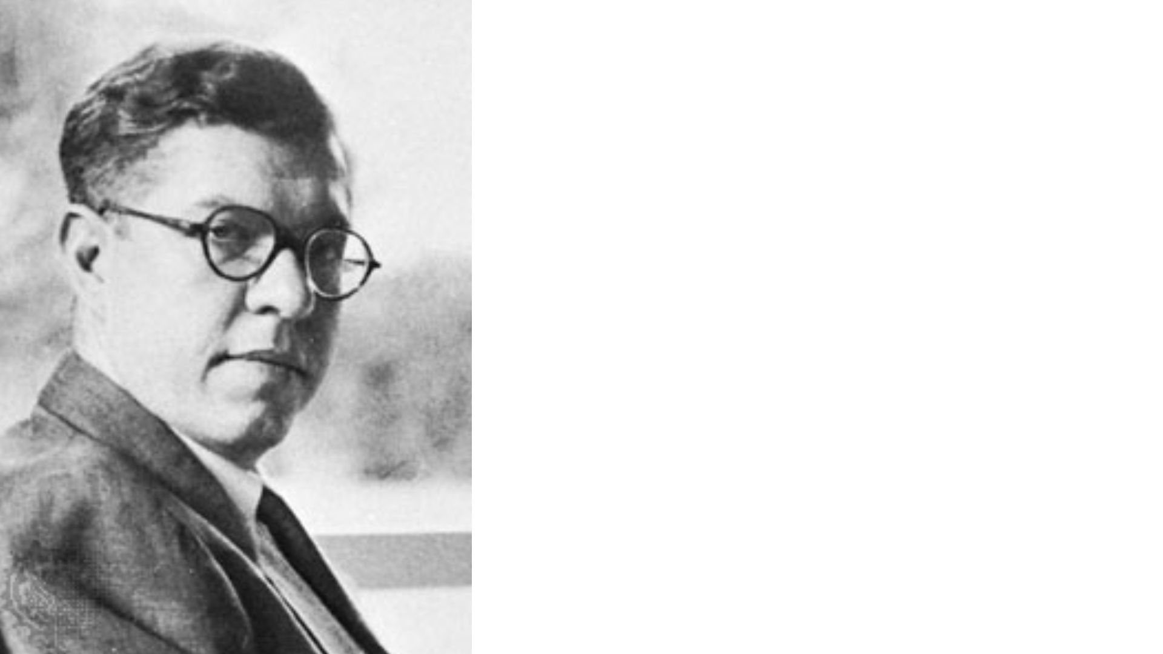
Sir Fred Hoyle,
in 1983, placed
the odds of a
single one-celled
organism occurring
by chance at 10^{40,000}

Slide 29
Probability of achieving a functional sequence of amino acids is “exceedingly small”, 1 in 10⁶³ (keep in mind there are only 10⁶⁹ atoms in our galaxy).
Robert Saver of MIT

Slide 30
Throw away logic!

Slide 31
Premise 1: Life has occurred. Premise 2: Life is specified. Premise 3: If life is due to chance, life has a small probability. Premise 4: Specific events of small probability do not occur by chance. Premise 5: Life is not due to a regularity (regularities are natural laws like gravity). Premise 6: Life is either due to regularity, chance, or design. Conclusion: Life is due to design.
Dembski

Slide 32
How then can some
scientists still hold
to this molecule-to-
man evolutionary
theory? Most would
say it simply does
not matter!
“Anthropic Principle”

Slide 33
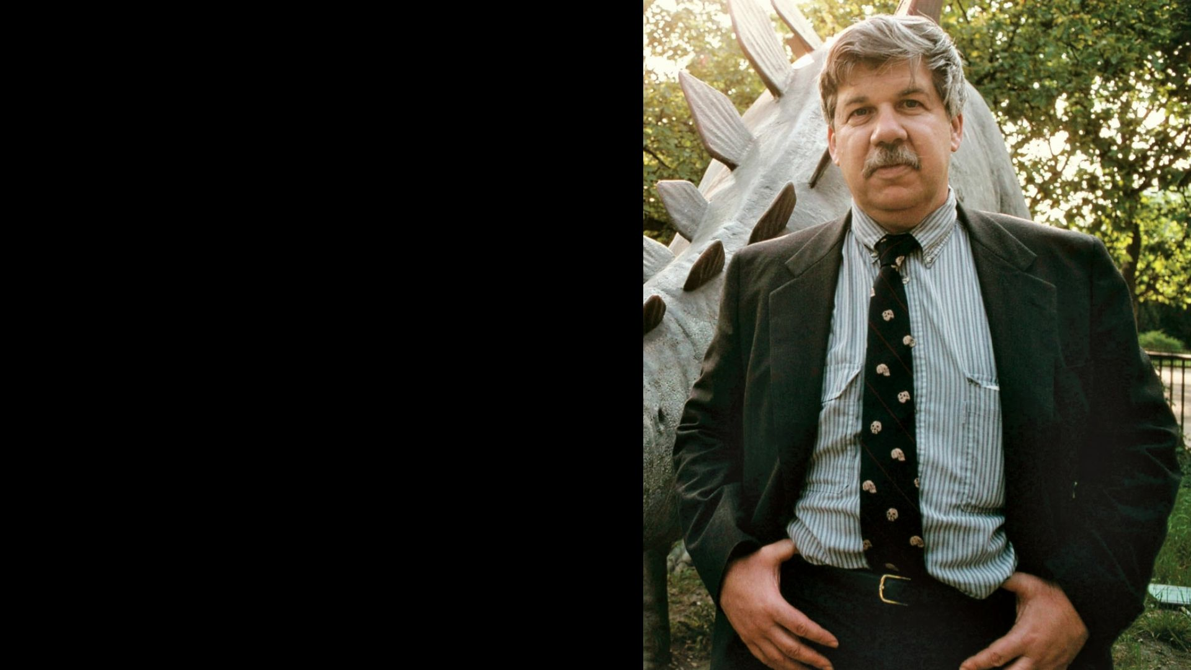
Glorious accident
which required 60
trillion contingent
events.
Stephen J. Gould

Slide 34
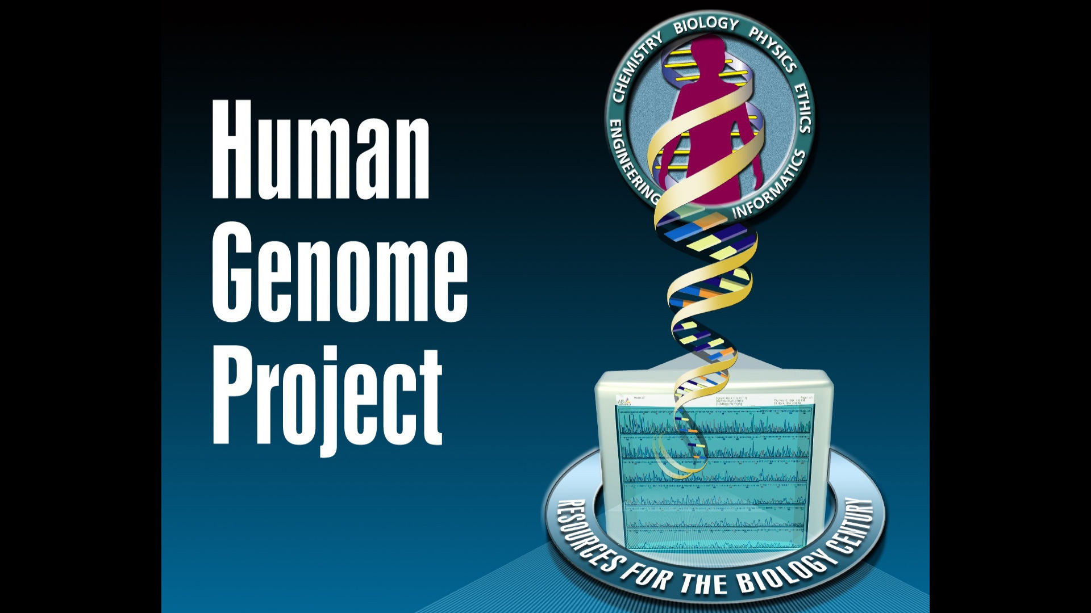

Slide 35
Francis Collins points to several “surprises” found
in our genome.

Slide 36
First, how little of the genome is used to code for protein, only 1.5% of our DNA, which represents 20 to 25,000 genes.

Slide 37
Second surprise was the number of genes in humans similar to other basic organisms.

Slide 38
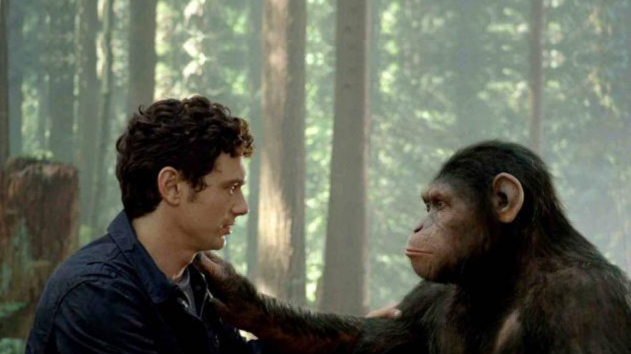
Humans and chimps are identical by 96%, even though humans have 23 paired chromosomes and chimps 24.

Slide 39
Are there valid answers to these surprises in the genome?

Slide 40
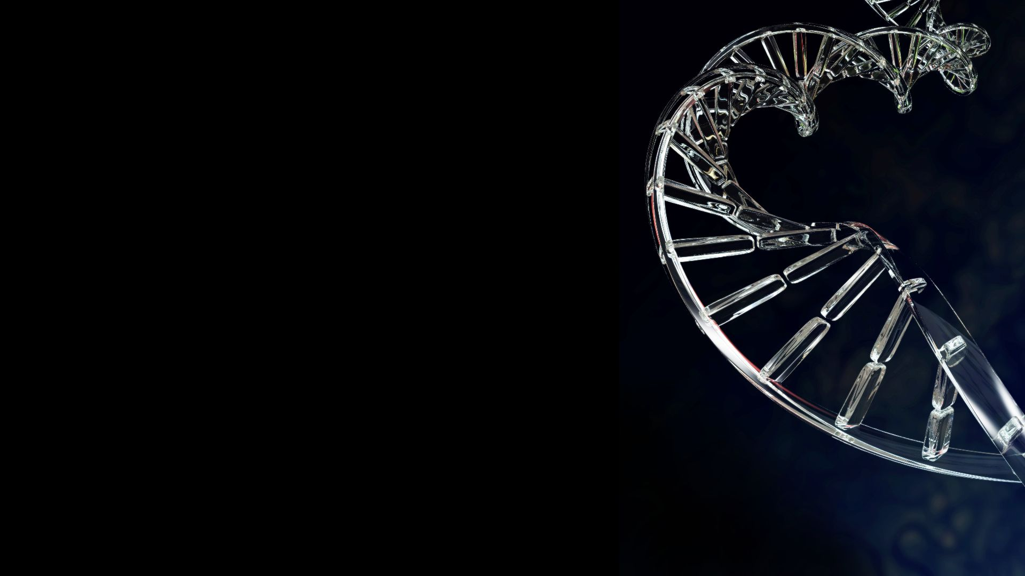
But non protein
producing DNA
perform many,
many functions.

Slide 41
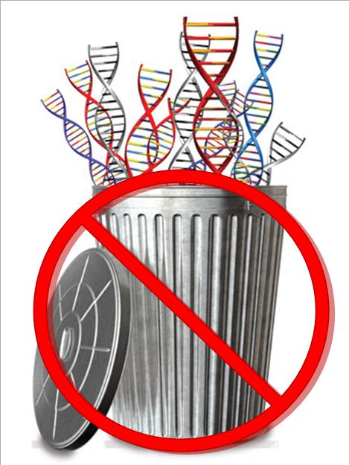
There is
NO JUNK DNA!

Slide 42
HOMOLOGY

Slide 43
So what about mutations?

Slide 44
For evolution to occur minor or slight mutations in DNA will not work. Large scale change in DNA destroys the organism!

Slide 45
Chimps and humans
do have similar DNA
but even a 4% difference
is huge.

Slide 46
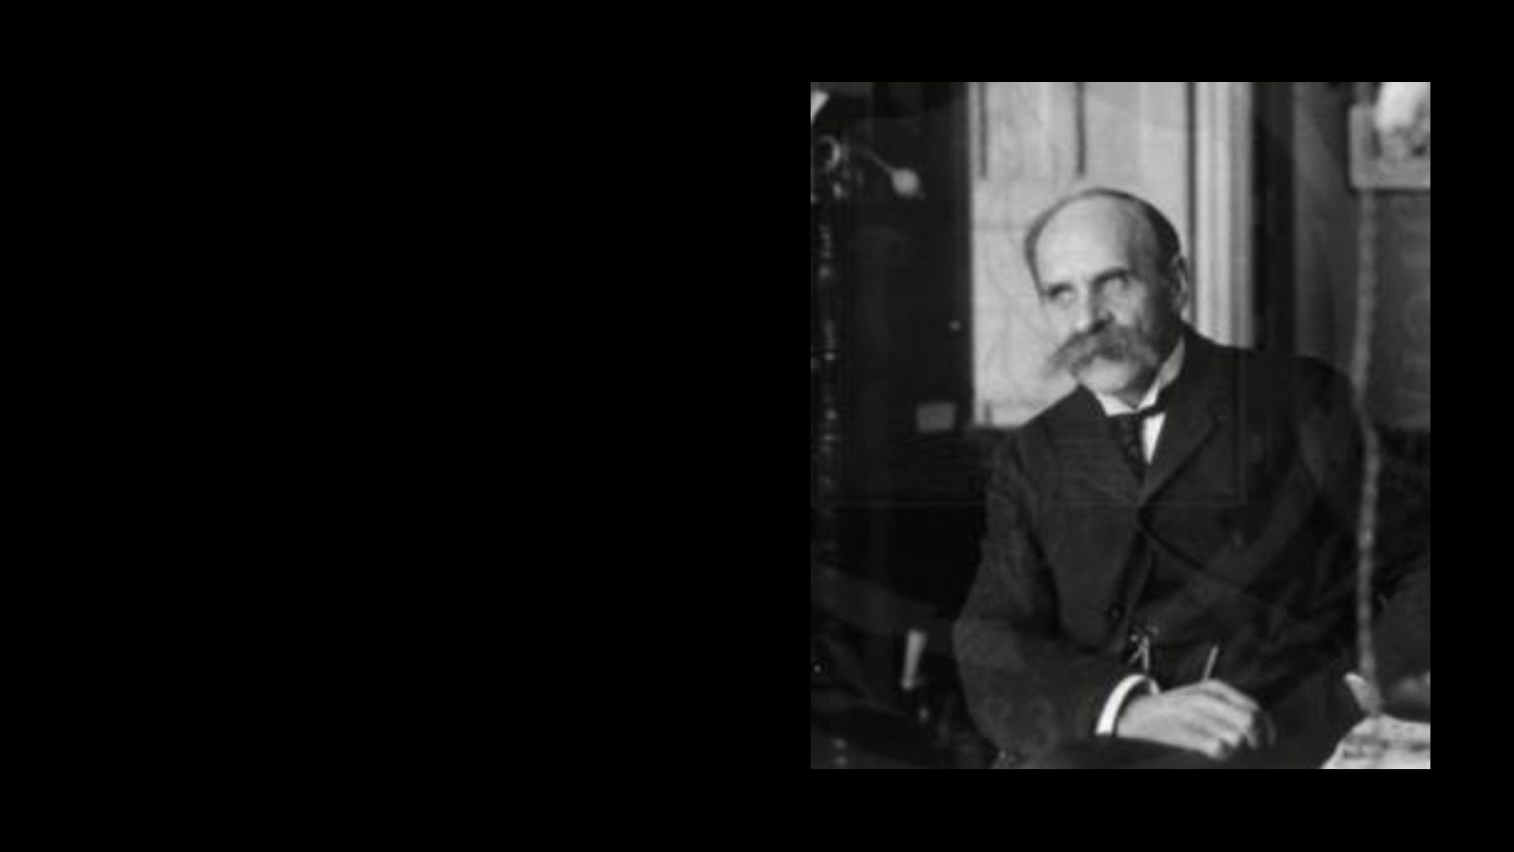
“Haldane’s
Dilemma”
J. B. S. Haldane

Slide 47
Per evolutionists, 40 million total separate mutation events separate humans and chimps. Haldane calculated an average mutation rate of 10⁶ -- population size of one million, a number compatible with evolutionists.

Slide 48
Given evolutionary timescales, this implies 150,000,000,000 forerunners to modern men!

Slide 49
Where are the fossils?

Slide 50
Then God said, “Let us make man in Our own image…”
Gen. 1:26

Slide 51
Death Blow to Evolution:
Epi Genetics

Slide 52
DNA does not by itself direct how individual proteins are assembled into larger systems such as cell type, tissues, organs, and body plan.

Slide 53
Example: microtubules make up the cytoskeleton that generate from each other, not DNA. Histones, are involved in the sequencing of protein (regulates storage and activation of DNA). Centrosomes from the mother egg, form poles and replicate themselves but have no DNA. Ion channels and…

Slide 54
…electromagnetic fields have significant morphologic effects (not derived from DNA). The sugar code, influence embryonic development and protein patterns and are transmitted directly from parent to daughter membranes.

Slide 55
Epigenetic structures are not amenable to mutations

Slide 57
DNA, genetics and the genome offer no more proof for evolution than homology did in the past or the fossil record now.

Slide 58
It is very presumptuous to say evolution is a fact when it is impossible to determine how even a single functioning protein could have occurred naturally.

Slide 59
The Case for Design restores western thought to the possibility that human life may have a purpose or sign to ___ beyond temporary material utility.
Stephen Mayer

Slide 60
The conclusion, when all has been heard, is: fear God and keep His commandments, because this applies to every person. For God will bring every act to judgment, everything which is hidden, whether it is good or evil.
Ecc. 12:13-14

